Slide 1


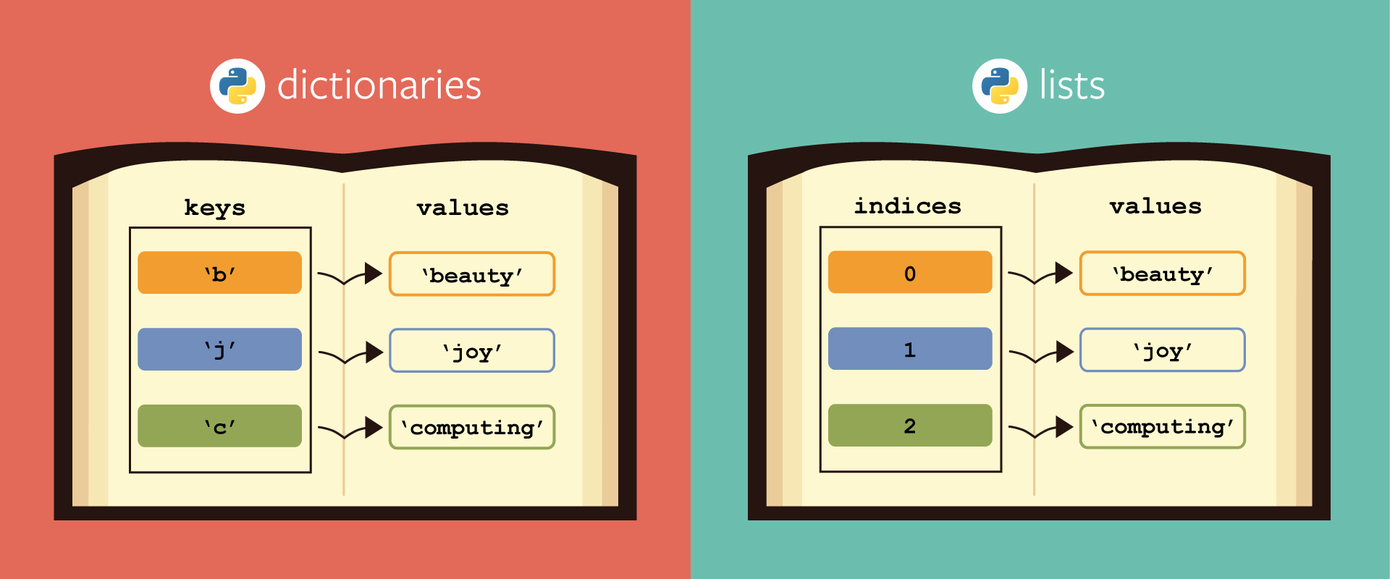

Lists and Dictionaries
Arrays and
Associative Arrays
Lists
and
Dictionaries
SoftUni Team
Technical Trainers
Software University
http://softuni.bg

Slide 2


Table of Contents
Operations with Lists
Reading Lists
Printing Lists
4. Associative Arrays
5. Dictionaries
Mapping Keys to Values
Dictionary methods – operator [], pop(),
operator in, etc.
2

Slide 3
Questions?
sli.do #python-fund

Slide 4
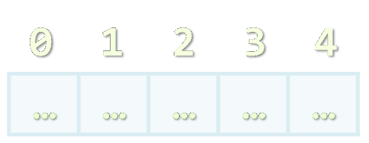
Lists

Slide 5
List
Provides the following operations:
[el1, el2, …] – creates list with the given items
len(list) – returns number of items in the List
list1 + list2 – concatenates the given lists
list * number – replicates the list number times
element in list – determines whether an item is in the list
for element is list: – iterates trough the lists items
5

Slide 6
List
Provides the following operations:
list[index] – returns the item in the given index
Indexes: 0 1 2 3 4
Indexes: -5 -4 -3 -2 -1
List: [1, 2, 3, 4, 5]
list[start:end] – returns the list of items between the given indexes
max(list)– returns the item with the max value from the list
min(list)– returns the item with the min value from the list
6

Slide 7
List
Provides the following operations:
list.append(item) – adds the item in the end of the list
list.count(item) – returns the number of occurences of item
list.index(item)– returns lowest positive index where the item is found
list.insert(index, item)– inserts the item at the index
list.pop(item = list[-1]) – removes and returns the last occurrence of item
list.remove(item) – removes the first occurance of item
7

Slide 8
List
Provides the following operations:
list.reverse() – reverses the list
list.sort() – sorts the list in increasing order
list.sort(reverse=True) – sorts the list in decreasing order
8

Slide 9

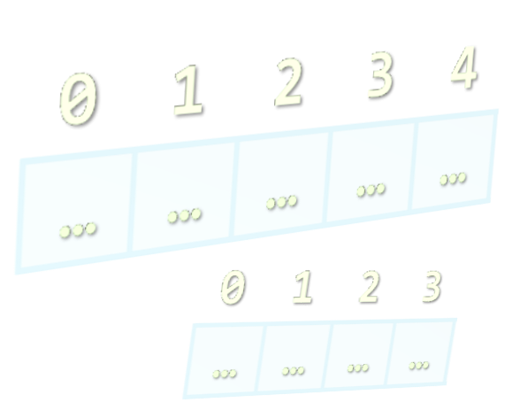
Reading Lists from the Console

Slide 10
Reading Lists From the Console
First, read from the console the length:
Next, create a list n and read its elements:
n = int(input())
list = []
for i in range(n):
list.append(int(input()))
# list += [int(input())]
10

Slide 11
Reading List Values from a Single Line
Lists can be read from a single line of space separated values:
string.split(' ') splits string by space and produces a list
2 8 30 25 40 72 -2 44 56
values = input()
items = values.split(' ')
nums = []
for i in items:
nums += [int(i)] # or nums.append(int(i))
Do everything at once
nums = [int(item) for item in input().split(' ')]
11

Slide 12
Printing Lists on the Console
Printing a list using a for-loop:
Printing a list using a string.join(…):
list = ["one", "two", "three", "four", "five", "six“]
for i in list:
print(i)
list = ["one", "two", "three", "four", "five", "six“]
print("; ".join(list))
12

Slide 13
ivan
gosho
pesho
0845-346-356
2350-452-167
1255-377-131
Associative Arrays

Slide 14
Associative Arrays (Maps, Dictionaries)
Associative arrays are arrays indexed by keys
Not by the numbers 0, 1, 2, … (like traditional arrays)
Hold a set of pairs {key → value}
Traditional array
Associative array
key
value
key
0 1 2 3 4
John Smith | +1-555-8976
Lisa Smith | +1-555-1234
Sam Doe | +1-555-5030
value
8 | -3 | 12 | 408 | 33
14

Slide 15
Dictionary Example – Phonebook
phonebook = {}
phonebook["John Smith"] = "+1-555-8976" phonebook["Lisa Smith"] = "+1-555-1234"
phonebook["Sam Doe"] = "+1-555-5030"
phonebook["Nakov"] = "+359-899-555-592"
phonebook["Nakov"] = "+359-2-981-9819" // Replace
phonebook.pop("John Smith", None)
for key, value in phonebook:
print("{0} --> {1}".format(key, value))
15

Slide 16
Dictionary
Dictionaries
Uses a hash-table + list or a balanced search tree
Keep the keys in their order of addition
phonebook = {
"John Smith“: "+1-555-8976", "Lisa Smith": "+1-555-1234",
"Sam Doe": "+1-555-5030",
"Nakov": "+359-899-555-592"
}
16

Slide 17
Dictionaries: Functionality
len() – returns the number of key-value pairs
.keys() – returns list of keys
.values() – a collection of all values
dict = {}
for key in dict.keys():
print(key)
print(", ".join(dict.values))
17

Slide 18
Dictionaries: Functionality (2)
Basic operations:
operator [] – get/set value for key
Member function .pop() – remove value for key
Member function .clear() – clear dictionary
print(dict['key']))
dict.pop('key', None )
None
dict.clear()
18

Slide 19
Dictionaries: Functionality (2)
Find key / value:
.has_key() – checks if a key is present in the dictionary (fast operation)
key in dict.values() – checks if a value is present in the dictionary (slow operation)
.get(key, default=None) – check if a key is present in the dictionary and ouputs the value (or returns the default value)
19

Slide 20
Iterating through Dictionaries
Live Demo
Dictionary
Pesho
Pesho
0881-123-987
0881-123-987
Gosho
Gosho
0881-456-987
0881-456-987
Alice
+359-899-55-592
Alice
+359-899-55-592
20

Slide 21
Problem: Odd Occurrences
Write a program to extract from given sequence of words all elements that present in it odd number of times (case-insensitive)
Words are given in a single line, space separated
Print the result elements in lowercase, in their order of appearance
Java C# PHP PHP JAVA C java
java, c#, c
3 5 5 hi pi HO Hi 5 ho 3 hi pi
5, hi
a a A SQL xx a xx a A a XX c
a, sql, xx, c
Check your solution here: https://judge.softuni.bg/Contests/Practice/Index/429#0
21

Slide 22
Solution: Odd Occurrences
line = input().lower()
words = line.split(' ')
counts = {}
for word in words:
if word in counts:
counts[word] += 1;
else:
counts[word] = 1;
results = []
for key, value in counts:
# TODO: add key to results if value is odd
print(", ".join(results))
counts[word] holds how many times word occurs in words
Check your solution here: https://judge.softuni.bg/Contests/Practice/Index/429#0
22

Slide 23
Problem: Count Real Numbers
Read a list of real numbers and print them in ascending order along with their number of occurrences
8 2.5 2.5 8 2.5
1.5 5 1.5 3
-2 0.33 0.33 2
2.5 -> 3
8 -> 2
1.5 -> 2
3 -> 1
5 -> 1
-2 -> 1
0.33 -> 2
2 -> 1
Check your solution here: https://judge.softuni.bg/Contests/Practice/Index/429#1
23

Slide 24
Solution: Count Real Numbers
nums = list(map(float, input().split(' ')))
counts = {}
for num in nums:
if num in counts:
counts[num] += 1
else:
counts[num] = 1
for num in sorted(counts.keys()):
print("{} -> {}".format(num, counts[num]))
counts[num] will hold how many times num occurs in nums
Check your solution here: https://judge.softuni.bg/Contests/Practice/Index/429#1
24

Slide 25

Associative Arrays and Lists
Live Exercises in Class

Slide 26






SoftUni Diamond Partners

Slide 27






SoftUni Diamond Partners

Slide 28







Lists and Dictionaries
https://softuni.bg/courses/

Slide 29
License
This course (slides, examples, demos, videos, homework, etc.) is licensed under the "Creative Commons Attribution-NonCommercial-ShareAlike 4.0 International" license
Attribution: this work may contain portions from
"Fundamentals of Computer Programming with C#" book by Svetlin Nakov & Co. under CC-BY-SA license
Icons from http://www.flaticon.com/ (credits: Freepik, Madebyoliver)
29
Notes:
© Software University Foundation – http://softuni.org
This work is licensed under the Creative Commons Attribution-NonCommercial-ShareAlike license.
29

Slide 30




Trainings @ Software University (SoftUni)
Software University – High-Quality Education, Profession and Job for Software Developers
softuni.bg
Software University Foundation
http://softuni.foundation/
Software University @ Facebook
facebook.com/SoftwareUniversity
Software University Forums
forum.softuni.bg
Notes:
© Software University Foundation – http://softuni.org
This work is licensed under the Creative Commons Attribution-NonCommercial-ShareAlike license.
30

